Slide 1
PLANNING SPORTS FACILITIES
Planning Process (Types of Planning)
Lecture-4
By
RABIA
Sports Sciences & Physical Education, LCWU

Slide 2
Planning
Planning is deciding in advance what is to be done when, where, how and by whom it is to be done.
Planning bridges the gaps from where we are to where we want to go
It Includes Objectives, Policies, Procedures & Programmes

Slide 3
Types of Planning
There are several types of Planning. But here we discuss four major types of planning
Strategic Planning
Tactical Planning
Operational Planning and
Contingency Planning

Slide 4
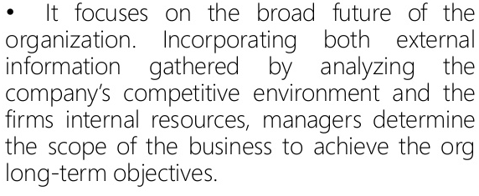
Strategic Planning

Slide 5
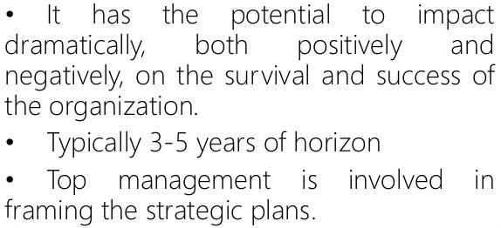
Strategic Planning

Slide 6
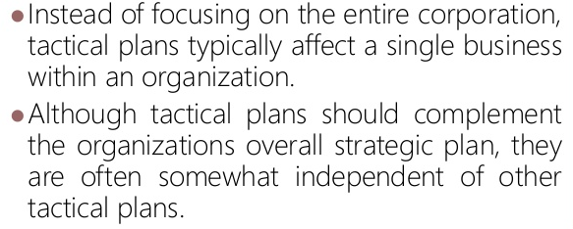
Tactical Planning

Slide 7
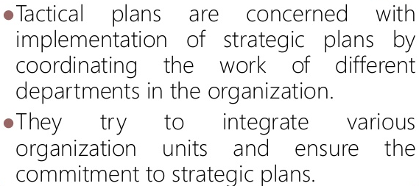
Tactical Planning

Slide 8
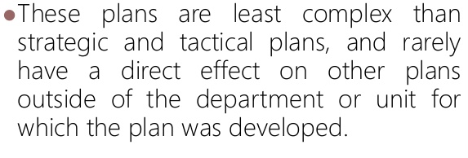
Operational Planning

Slide 9
Contingency Planning
This type of planning is made when something unexpected happens Or When something needs to be changed
It is necessary in situations when changes cannot be foreseen (predict)

